Slide 1
Replication: Can Violent Protest Change Local Policy Support?
ENOS, R., KAUFMAN, A., & SANDS, M. (2019). Can Violent Protest Change Local Policy Support? Evidence from the Aftermath of the 1992 Los Angeles Riot. American Political Science Review, 113(4), 1012-1028. doi:10.1017/S0003055419000340

Slide 2
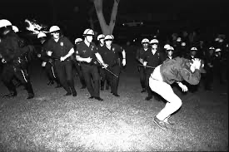
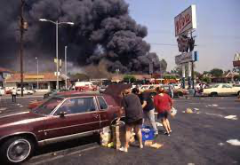
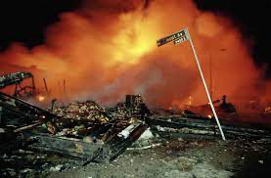
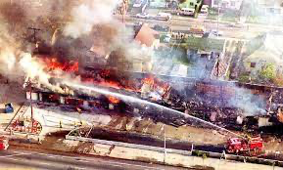
1992 LOS ANGELES RIOTS

Slide 3
A Few Notes
1) Study was conducted in 2017
2) Hubris
3) Difference-in-Difference

Slide 4
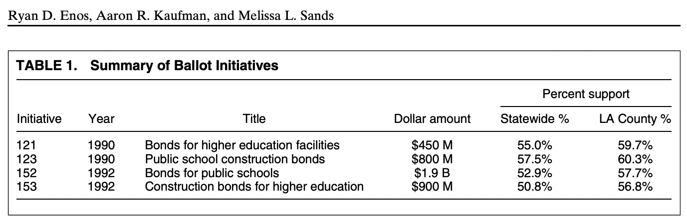
EdDiffi = (PubSchooli1992 - PubSchooli1990) - (HigherEdi1992 - HigherEdi1990)

Slide 5
Data Processing
merged_final$pct_pubschool_90 = merged_final$P123Y/merged_final$ballots_cast_90 merged_final$pct_pubschool_92 = merged_final$P152Y/merged_final$ballots_cast_92 merged_final$pct_highered_90 = merged_final$P121Y/merged_final$ballots_cast_90 merged_final$pct_highered_92 = merged_final$P153Y/merged_final$ballots_cast_92 merged_final$pubschool_dif = merged_final$pct_pubschool_92 - merged_final$pct_pubschool_90 merged_final$highered_dif = merged_final$pct_highered_92 - merged_final$pct_highered_90 merged_final$edu_dif = merged_final$pubschool_dif - merged_final$highered_dif
loading voting data and then processing it by: Calculating the difference in difference
merging election data into single df
calculating percentage that support public school (based on Yes votes for progressive policy)
calculating percentage that support highered
calculating their difference between 1990 and 1992
calculating education support difference by taking public school support away from highered support (diff in diff)

Slide 6
More Data Processing
Have precinct racial demographics, but don’t know distinct voting patterns of racial groups, need individual level data
“This presents an “Ecological Inference Problem” (Robinson 1950). We use the Ecological Inference methods developed by King (1997) to isolate behavior by racial group. “
“The outputs are estimates of what proportion of each group voted Yes on a given ballot initiative, for each precinct in our data.”
Recalculate differences after Eis
Use their code to generate standard errors
At last! Able to replicate.

Slide 7
Enos et al. Results : Race
Means
Riot as a positive shock for public school funding -> weighted mean positive
Riot as negative shock for public school funding -> weighted mean negative
Findings
EdDiffi weighted mean of 0.049 (95% confidence interval: [0.037, 0.061]
Whites (0.028, CI: [0.018, 0.039])
African Americans (0.073, CI:[0.066, 0.081])

Slide 8
My Results
EdDiffi (0.049 [0.037, 0.061])
The same
Whites (0.029, CI: [0.02, 0.039])
African Americans (0.072, CI:[0.04, 0.023])
Slightly different but not extremely.
Different packages? Rounding?

Slide 9
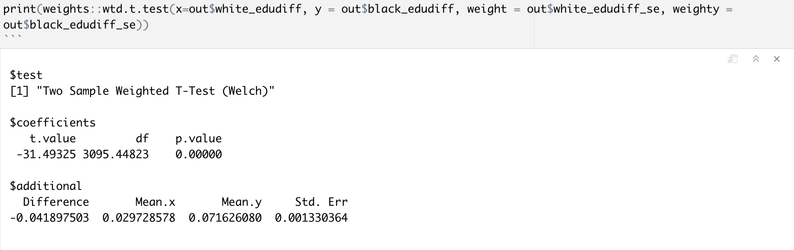
Weighted T Test
weighted t_test: pvalue = 0.00000
Very statistically significant
Can reject the null hypothesis that there is no difference between means
Sufficient evidence to think the mean levels in support for education is different between white and black populations in Los Angeles

Slide 10
RACE
My findings

Slide 11
Regressions:
Race
whiteed <- lm(out$edu_dif~out$whitepct)
- Effect of % white pop in a precinct on education difference
blacked <- lm(out$edu_dif~out$blackpct)
- Effect of % black pop in a precinct on education difference

Slide 12
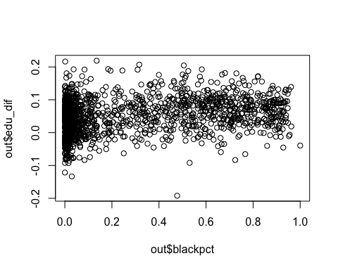
Black % Per Precinct
Characteristic | Beta | 95% CI | p-value
out$blackpct | 0.05 | 0.04, 0.06 | <0.001
Characteristic | Beta | 95% CI | p-value
out$whitepct | -0.04 | -0.05, -0.04 | <0.001
For every 1% increase in black population in a precinct, support for education increases on average by 0.05, holding all other variables constant.

Slide 13
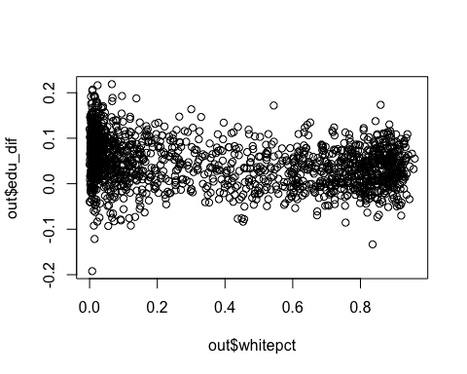
White % Per Precinct
Characteristic | Beta | 95% CI | p-value
out$whitepct | -0.04 | -0.05, -0.04 | <0.001
For every 1% increase in black population in a precinct, support for education increases on average by 0.05, holding all other variables constant.

Slide 14
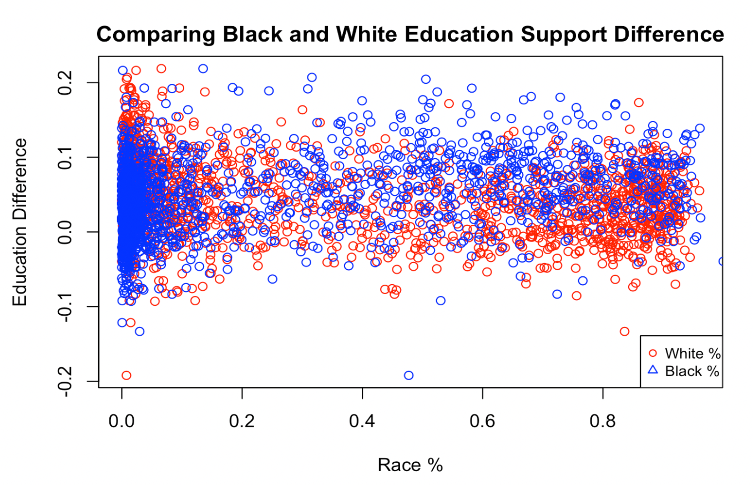

Slide 15
Distance
Enos et al Findings

Slide 16
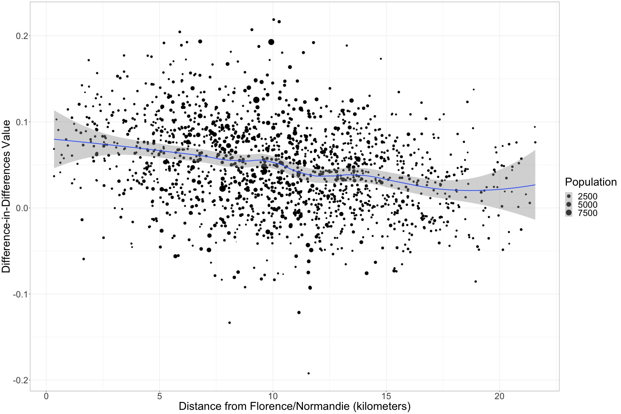
FIGURE 2. A Loess Line and Scatterplot Displaying the Relationship Between Each Precinct’s Distance From Florence and Normandie and that Precinct’s EdDiff Values for all Voters in 1,676 Precincts in the LA Basin. Points are Sized, and the Loess Line Weighted, by the Voting Age Population in Each Precinct

Slide 17
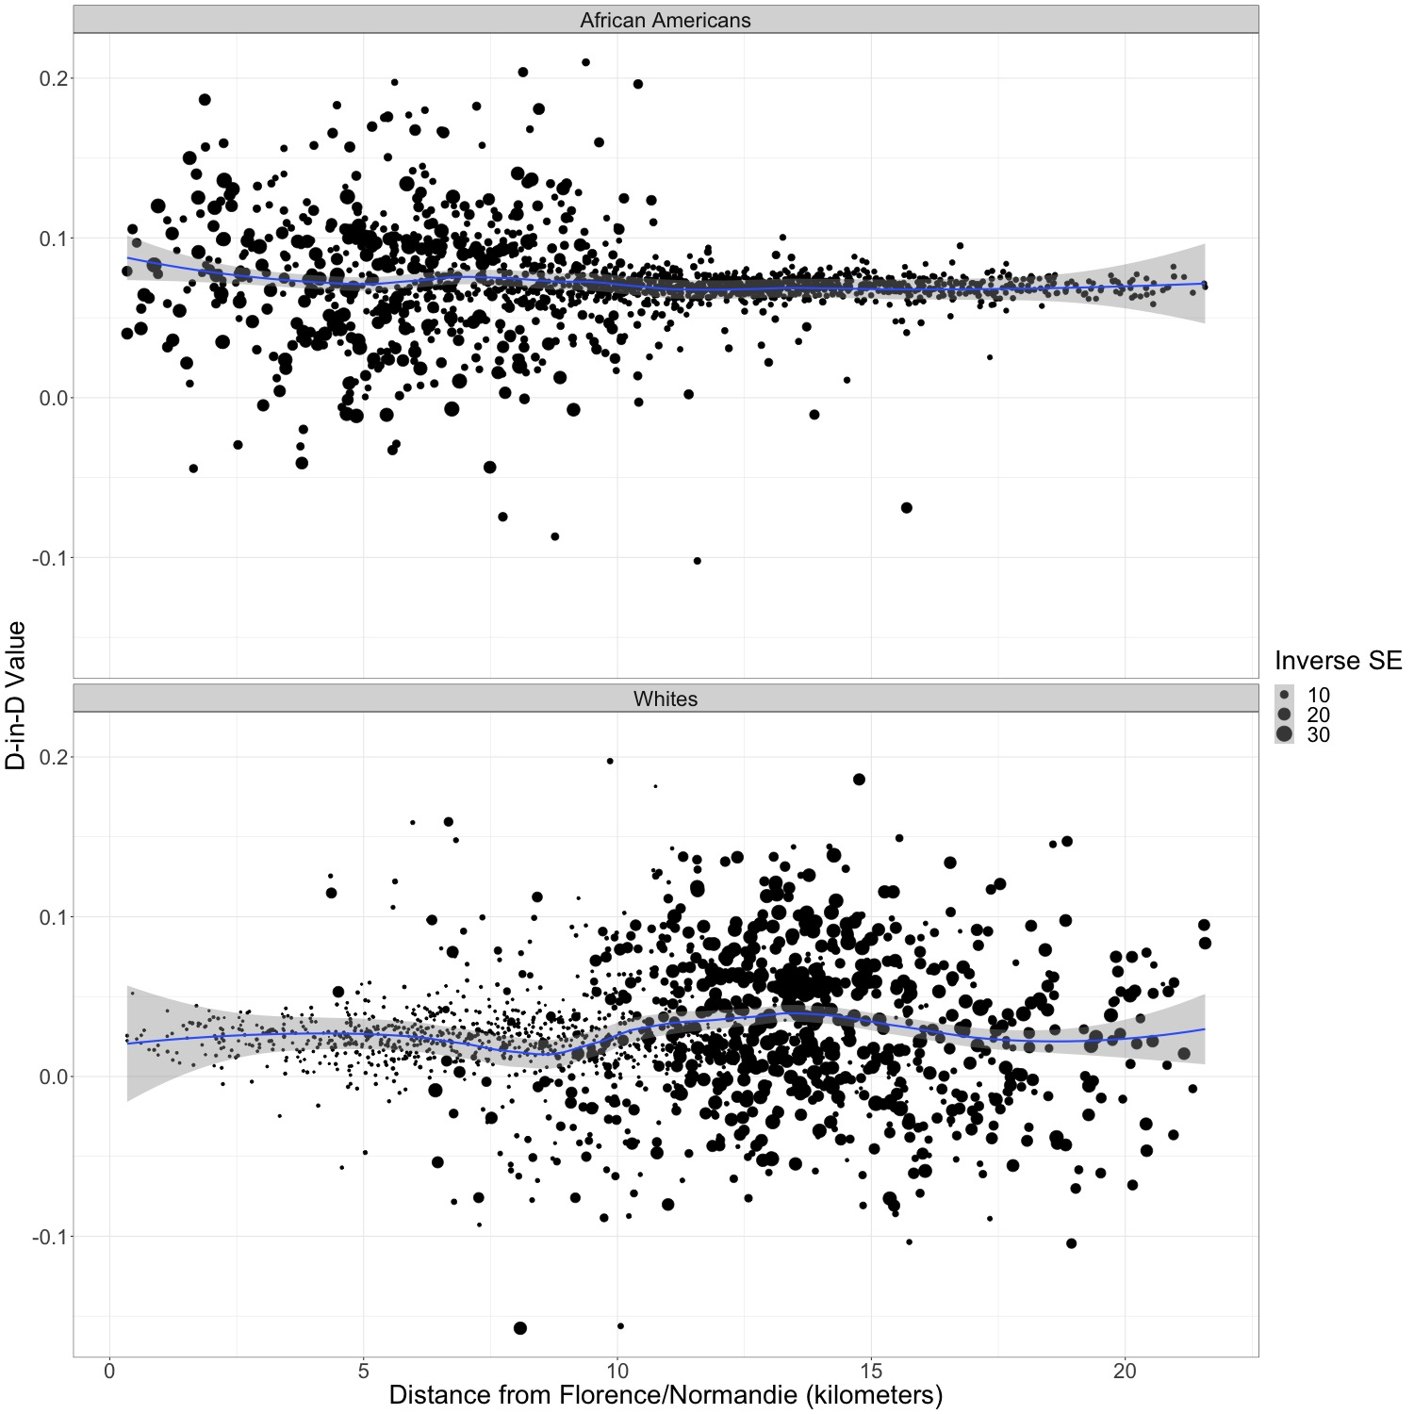
Figure C4 from Enos et al. Appendix showing distance based on race

Slide 18
Distance
My findings

Slide 19
tbl_regression(lm(edu_dif ~ dist, data=dat, weight=dat$pop18))
Characteristic | Beta | 95% CI | p-value
dist | -0.04 | -0.04, -0.03 | <0.001

Slide 20
(Measured in 10s of Kilometers)
par(mfrow=c(3,1)) plot(edu_dif ~ dist, data=dat, weight=dat$pop18) # in area
plot(edu_dif ~ dist + I(dist^2), data=dat, weight=dat$pop18) # further from area
plot(edu_dif ~ dist + I(dist^2) + I(dist^3), data=dat, weight=dat$pop18) # further from area

Slide 21
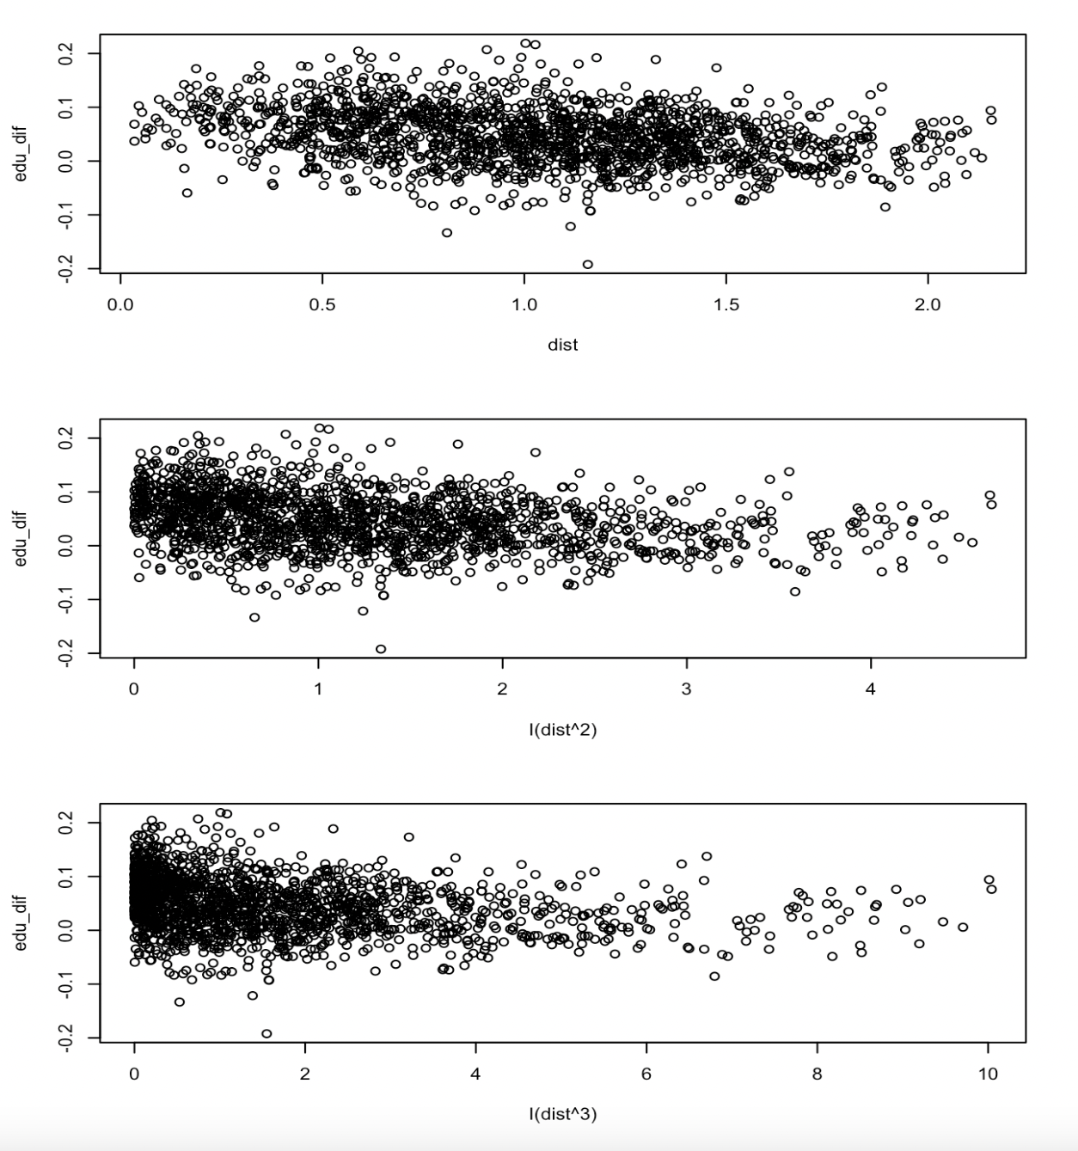

Slide 22
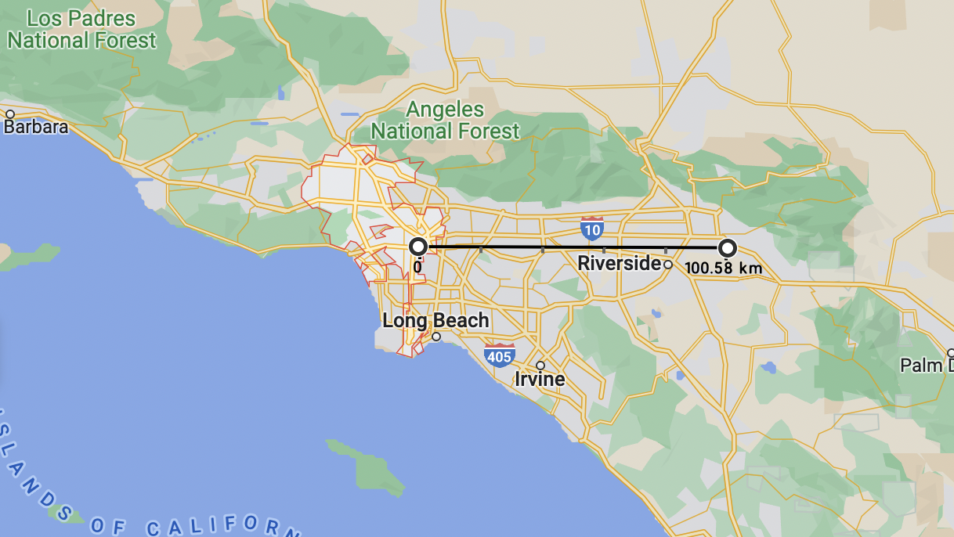

Slide 23
summary(lm(dat$edu_dif ~ dat$dist + dat$blackpct)) ## Call: ## lm(formula = dat$edu_dif ~ dat$dist + dat$blackpct) ## ## Residuals: ## Min 1Q Median 3Q Max ## -0.242832 -0.032545 0.001077 0.031269 0.177000 ## ## Coefficients: ## Estimate Std. Error t value Pr(>|t|) ## (Intercept) 0.060855 0.005143 11.832 < 2e-16 *** ## dat$dist -0.020913 0.003817 -5.478 4.95e-08 *** ## dat$blackpct 0.029303 0.005461 5.366 9.19e-08 *** ## --- ## Signif. codes: 0 '***' 0.001 '**' 0.01 '*' 0.05 '.' 0.1 ' ' 1 ## ## Residual standard error: 0.04863 on 1673 degrees of freedom ## Multiple R-squared: 0.1069, Adjusted R-squared: 0.1059 ## F-statistic: 100.1 on 2 and 1673 DF, p-value: < 2.2e-16
Regressed Education Difference against Distance and Black %
dat$dist -0.020913 pvalue 4.95e-08 ***
dat$blackpct 0.029303 pvalue 9.19e-08 ***

Slide 24
summary(lm(dat$edu_dif ~ dat$dist * dat$blackpct))
## ## Call: ## lm(formula = dat$edu_dif ~ dat$dist * dat$blackpct) ## ## Residuals: ## Min 1Q Median 3Q Max ## -0.244222 -0.032306 0.001228 0.031415 0.176916 ## ## Coefficients: ## Estimate Std. Error t value Pr(>|t|) ## (Intercept) 0.062016 0.005595 11.084 < 2e-16 *** ## dat$dist -0.021965 0.004307 -5.100 3.79e-07 *** ## dat$blackpct 0.024654 0.010367 2.378 0.0175 * ## dat$dist:dat$blackpct 0.006638 0.012578 0.528 0.5977 ## --- ## Signif. codes: 0 '***' 0.001 '**' 0.01 '*' 0.05 '.' 0.1 ' ' 1 ## ## Residual standard error: 0.04864 on 1672 degrees of freedom ## Multiple R-squared: 0.1071, Adjusted R-squared: 0.1055 ## F-statistic: 66.83 on 3 and 1672 DF, p-value: < 2.2e-16
Interaction
p value = 0.5977
Not have an effect in combination.
Maybe because precincts with high % of black people were close to the riots anyway?

Slide 25
